Slide 1
Introduktion til Programmering og Problemløsning (PoP)
Jon Sporring
Department of Computer Science
2022/09/02

Slide 2
F# er en lommeregner
Leksikografisk virkefelt
% dotnet fsi
Microsoft (R) F# Interactive version 12.0.4.0 for F# 6.0
Copyright (c) Microsoft Corporation. All Rights Reserved.
For help type #help;;
> 357;;
val it: int = 357
> 864;;
val it: int = 864
> 357+864;;
val it: int = 1221
> let a = 357;;
val a: int = 357
> let b = 864
- let c = a+b
- printfn "%A + %A = %A" a b c;;
357 + 864 = 1221
val b: int = 864
val c: int = 1221
val it: unit = ()
3 måder at køre (execute / run) programmet på:
dotnet fsi -> indtast myFirstFsharp.fsx
dotnet fsi myFirstFsharp.fsx
dotnet run

Slide 3
F# funktioner
> let a = 3
- let b = 4
- let mul () = a*b;;
val a: int = 3
val b: int = 4
val mul: unit -> int
> let y = mul ();;
val y: int = 12
% dotnet fsi
Microsoft (R) F# Interactive version 12.0.4.0 for F# 6.0
Copyright (c) Microsoft Corporation. All Rights Reserved.
For help type #help;;
> let m = 3*4;;
val m: int = 12
> let mul x = 3*x;;
val mul: x: int -> int
> let y = mul 4;;
val y: int = 12

Slide 4
Nedtælling med Rekursion
let rec countDown n =
printfn "%A" n
match n with
0 -> ()
| _ -> countDown (n-1)
countDown 5
sideeffekt
countDown 5
~>countDown (countDown 4)
~>countDown (countDown (countDown 3))
~>countDown (countDown (countDown (countDown 2)))
~>countDown (countDown (countDown (countDown (countDown 1))))
~>countDown (countDown (countDown (countDown (countDown (countDown 0)))))
~>countDown (countDown (countDown (countDown (countDown ()))))
~>countDown (countDown (countDown (countDown ())))
~>countDown (countDown (countDown ()))
~>countDown (countDown ())
~>countDown ( )
~> ( )
Regler for rekursion
1. Der skal være et basetilfælde
2. Funktionen skal kalde sig selv evt. indirekte
3. Rækken af rekursive kald skal ramme basetilfældet indenfor endelig tid

Slide 5
Nedtælling med while-løkke
let countDown n =
let mutable i = n
while i >= 0 do
printfn "%A" i
i <- i - 1
countDown 5
Dynamisk virkefelt
Regler for while-løkker
1. Der skal være en slutbetingelse
2. Løkken skal helst nærme sig slutbetingelsen
countDown 5
i = 5
i <- 4
i <- 3
i <- 2
i <- 1
i <- 0
i <- -1
~> ( )
Bunken (The Heap)
i
3

Slide 6
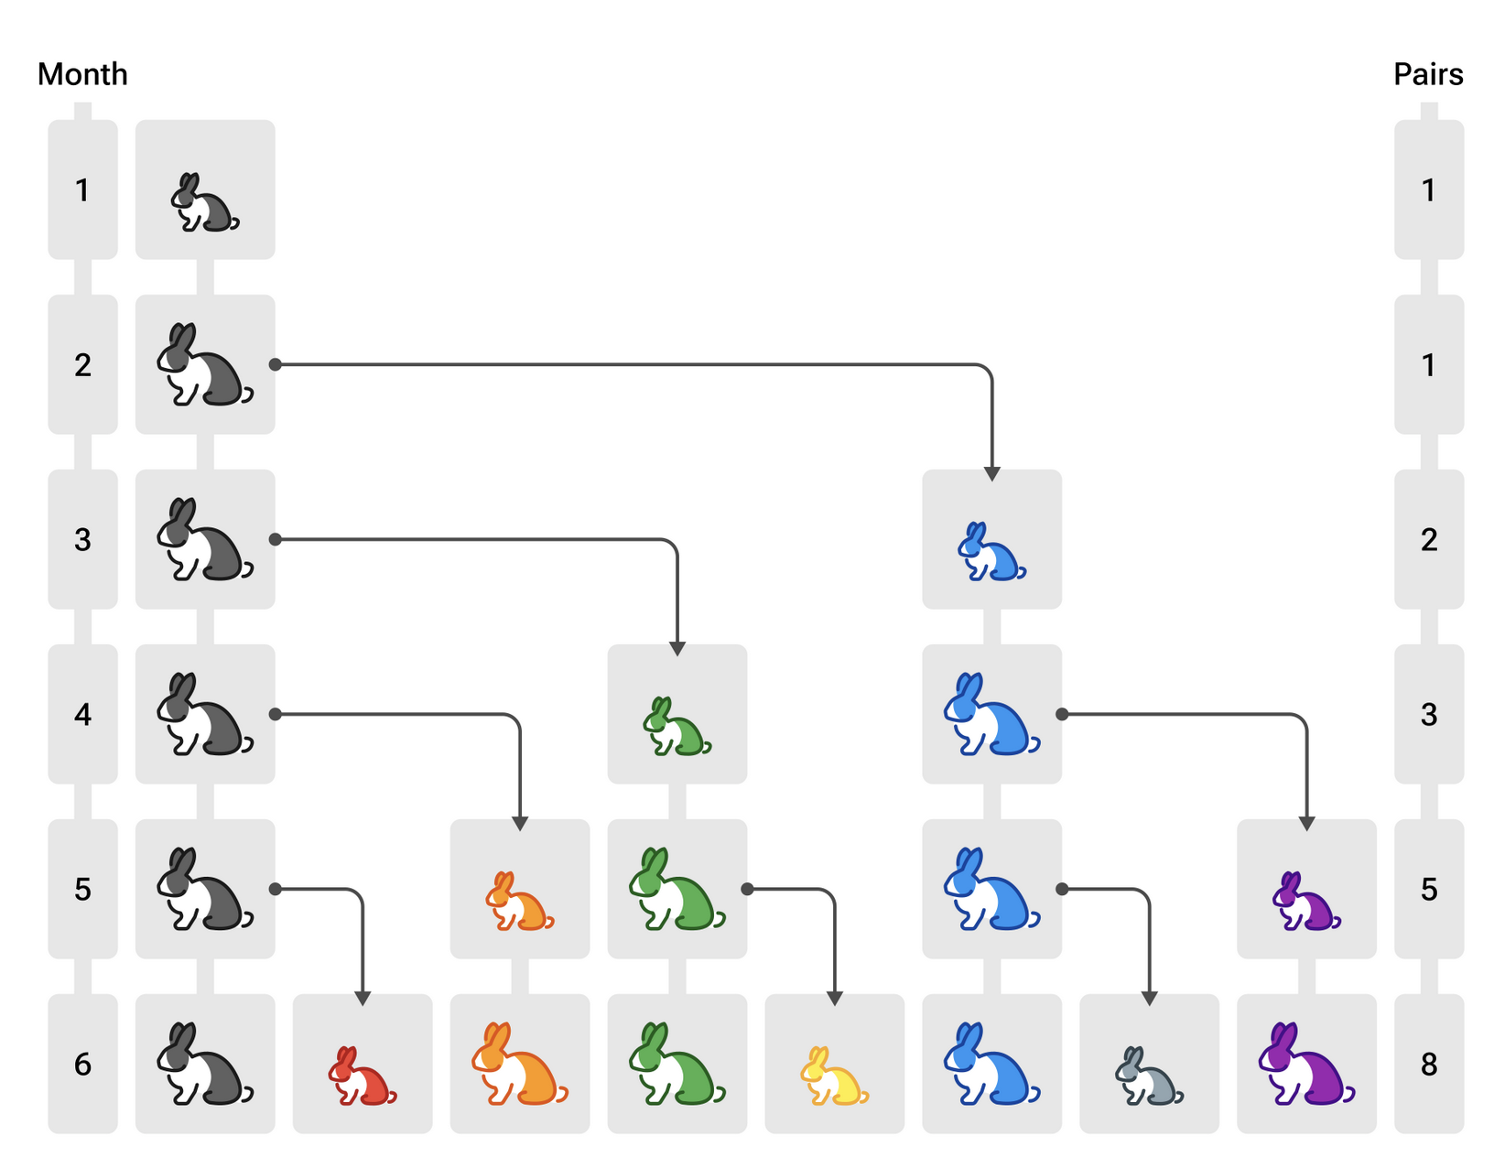
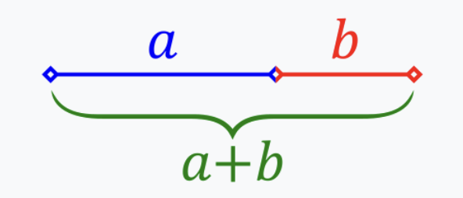
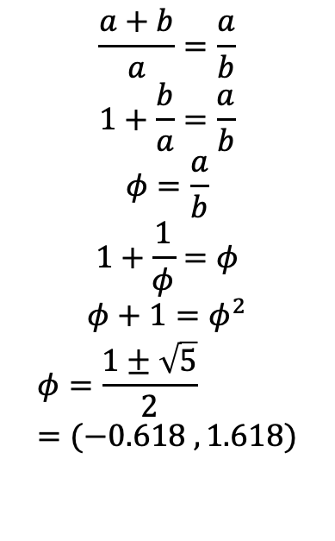
Fibonacci: 0 1 1 2 3 5 8 13 21 …
Kanin par: Nyt par efter 2 måneder
Det gyldne snit
$$\frac{a+b}{a}=\frac{a}{b}$$
$$1+\frac{b}{a}=\frac{a}{b}$$
$$φ=\frac{a}{b}$$
$$1+\frac{1}{φ}=φ$$
$$φ+1=φ^{2}$$
$$φ=\frac{1±\sqrt{5}}{2}=(−0.618 , 1.618)$$
F(0) = 0
F(1) = 1
F(n) = F(n-1)+F(n-2)
b = F(n-2)
a = F(n-1)
a+b= F(n-1)+F(n-2) = F(n)

Slide 7
Fibonacci: 0 1 1 2 3 5 8 13 21 …
Recursive
% time dotnet fsi fibRecursive.fsx
fib(0) = 0
fib(1) = 1
fib(2) = 1
fib(3) = 2
fib(4) = 3
fib(5) = 5
…
fib(44) = 701408733
fib(45) = 1134903170
dotnet fsi fibRecursive.fsx 14.34s user …
let rec fib n =
match n with
0 -> 0
| 1 -> 1
| _ ->
fib (n - 1) + fib (n - 2)
let mutable i = 0
while i <= 45 do
printfn "fib(%d) = %d" i (fib i)
i <- i + 1
F(0) = 0
F(1) = 1
F(n) = F(n-1)+F(n-2)

Slide 8
Rekursion
Fib(5)
~> fib(4) + fib(3)
~> (fib(3)+fib(2)) + (fib(2)+fib(1))
~> ((fib(2)+fib(1)) + (fib(1)+fib(0)))+((fib(1)+fib(0))+1)
~> (((fib(1)+fib(0))+1) + (1+0))+((1+0)+1)
~> (((1+0)+1) + 1)+(1+1)
~> ((1+1) + 1)+2
~> (2 + 1)+2
~> 3+2
~> 5
F(0) = 0
F(1) = 1
F(n) = F(n-1)+F(n-2)

Slide 9
Rekursion
5
F(0) = 0
F(1) = 1
F(n) = F(n-1)+F(n-2)
4
3
3
2
2
1
2
1
1
0
1
0
1
0

Slide 10
Fibonacci: 0 1 1 2 3 5 8 13 21 …
Imperative
fib 5
prevPrev = 0
prev = 1
i = 2
curr = 1
prevPrev <- 1
prev <- 1
i <- 3
curr = 2
prevPrev <- 1
prev <- 2
i <- 4
curr = 3
prevPrev <- 2
prev <- 3
i <- 5
curr = 5
prevPrev <- 3
prev <- 5
i <- 6
~> 5
F(0) = 0
F(1) = 1
F(n) = F(n-1)+F(n-2)
let fib n =
match n with
0 -> 0
| 1 -> 1
| _ ->
let mutable prevPrev = 0
let mutable prev = 1
let mutable i = 2;
while i <= n do
let curr = prev + prevPrev
prevPrev <- prev
prev <- curr
i <- i + 1
prev
let mutable i = 0
while i <= 45 do
printfn "fib(%d) = %d" i (fib i)
i <- i + 1
% time dotnet fsi fibImperative.fsx
…
fib(44) = 701408733
fib(45) = 1134903170
dotnet fsi fibImperative.fsx 0.98s user …

Slide 11
Resumé
Denne video fortalte om:
F# som en lommeregner
Konstanter, typer, bindinger, betingelser, løkker, printfn, mutérbare værdier
Fibonaccis talrække og sammenlignen mellem rekursiv og while-løkke

